Slide 1
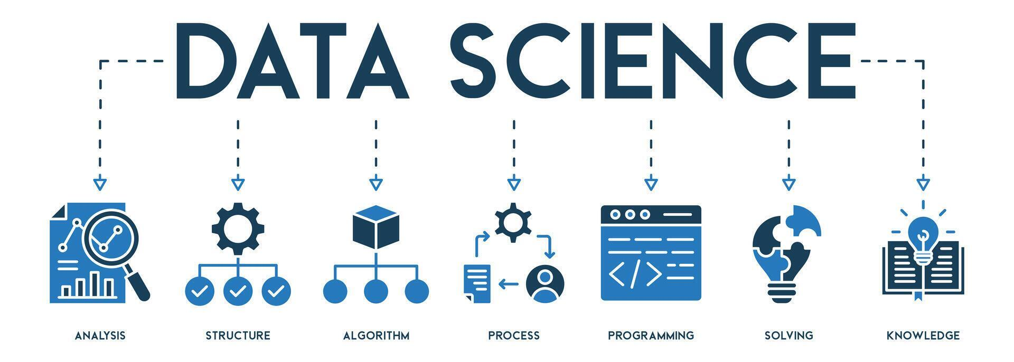

Salary Median Classification for Data Science Roles
Predicting Above‑Median vs. Below‑Median Salaries Using Machine Learning
By Aaron Niecestro

Slide 2
Project Overview
Goal: Classify whether a data‑science professional earns above or below the median salary using machine‑learning models.
Why This Matters: Organizations need clear, data‑driven insights to support compensation planning, pay equity, and competitive hiring.
What This Project Covers:
Understanding the dataset and key salary‑related features
Building and comparing multiple ML classification models
Identifying the strongest predictors of higher salary outcomes
Selecting the best model for accuracy and interpretability
Providing actionable insights for HR, recruiting, and workforce strategy
Outcome: A reliable, interpretable salary‑classification model that highlights the factors most strongly associated with higher compensation.

Slide 3
Introduction

Slide 4
Understanding Data Science Salaries
What This Dataset Represents
Real salary records for U.S. data‑science and analytics professionals
Includes job titles, experience levels, company size, remote work, and employment type
Median salary category used as a stable classification target
Why Salary Analysis Matters
Salary variation is large across roles, industries, and experience levels
Companies need data‑driven compensation benchmarks
Job seekers want clarity on what drives higher pay
Supports pay‑equity, hiring strategy, and workforce planning
Purpose of This Analysis
Build machine‑learning models to classify salaries as above or below median
Identify the strongest predictors of higher compensation
Provide interpretable insights for HR, recruiting, and leadership

Slide 5
History of Data Science Salaries — Why This Analysis Matters
2010–2014
Big Data Era
Companies adopt Hadoop/Spark
Demand for data talent surges
Salaries rise due to scarcity
2015–2018
ML Goes Mainstream
Python + ML libraries mature
Specialized roles emerge
Salary gaps widen
2018–2020
Tech Giants Inflate Pay
FAANG compensation spikes
Equity packages reshape salary norms
2020–2022
Remote Work Shift
National hiring equalizes pay
Remote roles often pay more
2023–2025
AI & LLM Boom
New high‑pay AI roles appear
Salary volatility increases
2026
Why This Analysis Now
AI automation reshapes job duties
Hybrid work becomes standard
Senior talent remains competitive
Entry‑level supply grows
Organizations need data‑driven salary benchmarks

Slide 6
Preview of Data
&
Analysis Approach

Slide 7
Data Description
U.S.‑only subset used for consistent compensation comparison
Data has 44,225 observations
Median Salary Category (Target)
  Below (Median < $147,700)
  Above (Median ≥ 147,700)
Key Feature Groups
  Job & Experience Attributes
    Experience level
    Job title group
    Work year (2020–2025)
    Data age (recency of salary record)
  Employment & Work Arrangement
    Employment type (full‑time, contract, etc.)
    Employee residence
    Employee remote ratio (on‑site, hybrid, remote)
    Employer remote ratio (company’s remote policy)
  Company Attributes
    Company size (small, medium, large)
Why These Features Matter
  These attributes capture the most important drivers of salary variation:
  Seniority
  Job specialization
  Company scale
  Remote work flexibility
  Geographic factors

Slide 8
Snapshot of the Data Table
Job Title | Experience Level | Company Size | Remote Ratio | Employee Residence | Salary Median Category
Data Analytics | Entry-Level | Medium | 0.0 | United States | Below-Median
Other Tech | Senior-Level | Medium | 0.0 | United States | Above-Median
Other Tech | Middle-Level | Medium | 50.0 | United States | Above-Median
Other Tech | Senior-Level | Medium | 0.0 | United States | Above-Median
ML/AI Engineering | Senior-Level | Medium | 0.0 | United States | Above-Median

Slide 9
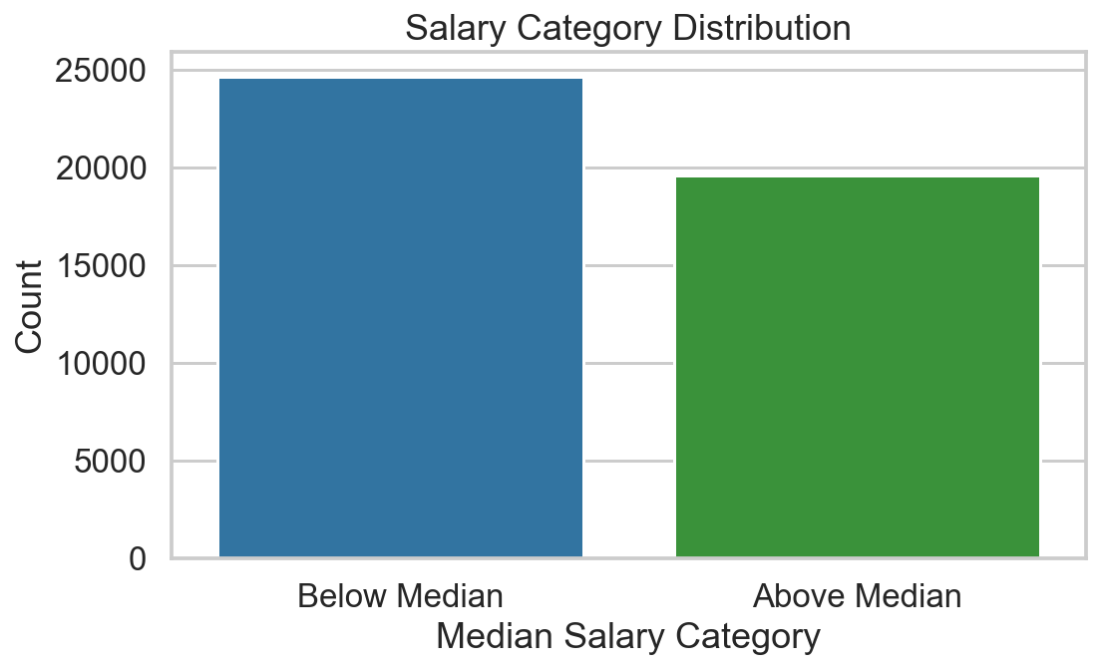
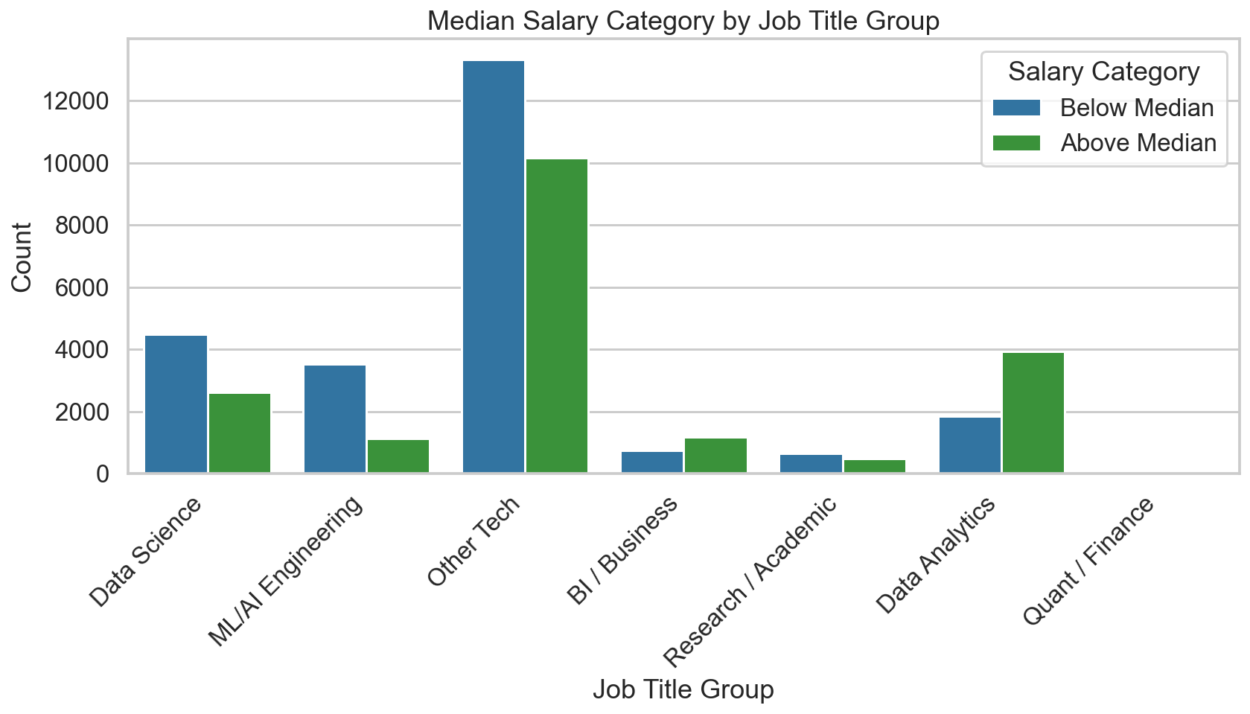
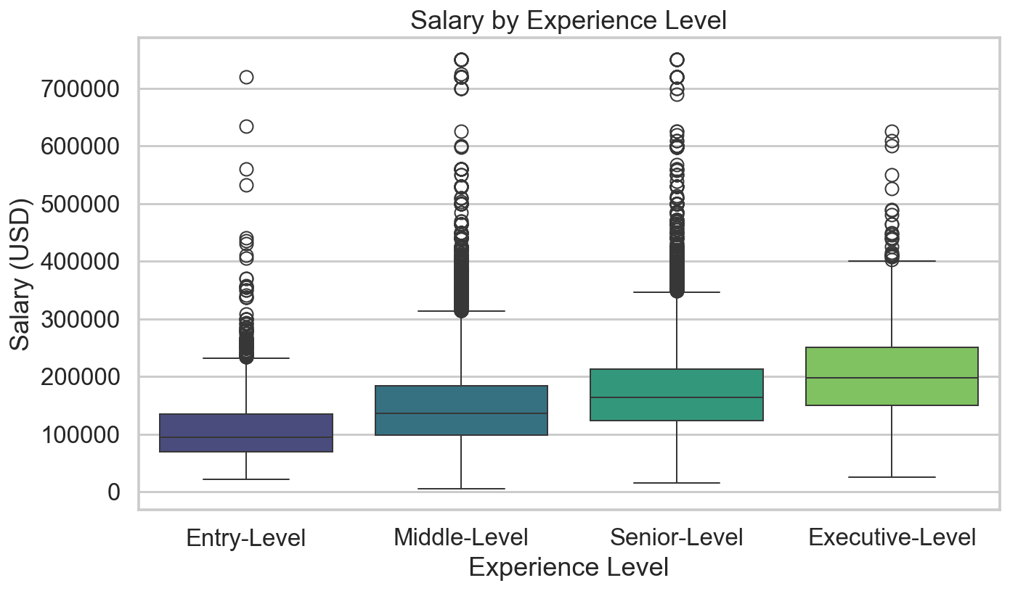
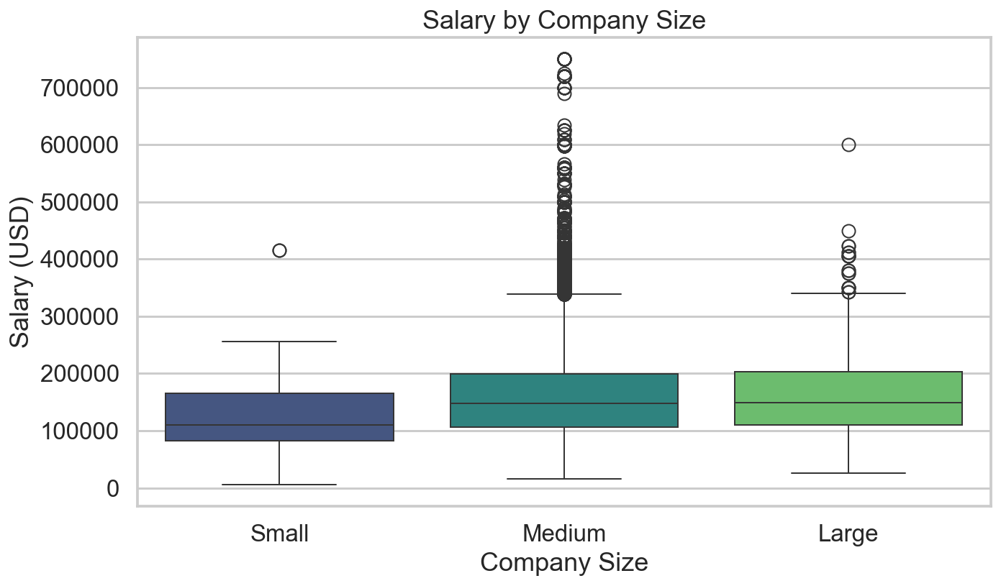

Slide 10
Insights from Data and Graphs
This dataset contains structured salary records for U.S. data‑science professionals. Each row represents one job record with attributes describing the role, company, and work arrangement.”
Senior and specialized roles consistently fall above the median salary, while entry‑level and generalist roles cluster below it.
Job title group emerges as the #1 driver of salary in both feature importance and SHAP analysis.

Slide 11
Key Insights from the Data
1. Job Role & Seniority Drive Salary
  Senior and specialized roles consistently fall above the median
  Entry‑level and generalist roles cluster below the median
2. Experience Strongly Predicts Compensation
  Clear upward trend: more experience → higher salary
3. Company Size Matters
  Large companies pay more on average
  Small companies show lower salary distributions
4. Remote Work Influences Pay
  Fully remote roles trend higher
  On‑site roles cluster below median
5. Median Salary Is a Stable Target
  Less sensitive to outliers than mean salary
  Provides a reliable classification threshold

Slide 12
Modeling Approach
Goal:
Models Tested
Interpretable Models
Logistic Regression
Naive Bayes
Distance & Margin‑Based Models
K‑Nearest Neighbors
Support Vector Machines (Linear & RBF)
Ensemble Models
Decision Tree
Random Forest
Gradient Boosting
AdaBoost
Extra Trees
How We Evaluated Performance
Each model was trained on the same data split (70/30) and assessed using:
Accuracy — overall correctness
Precision — correctness of above‑median predictions
Recall — ability to find true above‑median earners
F1 Score — balance of precision and recall
Final Model Variables Used:
Experience Level
Employment Type
Job Title by Group
Employee residence
Company Size
Work Calendar Year
Employer Remote Type
Why This Matters
Testing multiple model families ensures we select the most accurate, stable, and interpretable approach for salary classification — not just the first model that works.
To identify the most reliable salary‑classification model, we evaluated a diverse set of machine‑learning algorithms — from simple interpretable models to advanced nonlinear ensembles.
Area under the Curve (AUC) — overall ranking ability (most reliable metric)

Slide 13
How We Evaluate Model Performance
Accuracy — Overall Correctness
What it means: How often the model is right.
Precision — Correct High‑Salary Predictions
What it means: When the model predicts “above median,” how often it’s correct.
Recall — Ability to Find High Earners
What it means: How many real above‑median earners the model successfully identifies.
F1 Score — Balanced Quality
What it means: A balance of precision and recall — useful when classes differ.
ROC‑AUC — Separation Strength
What it means: How well the model distinguishes between high and low earners.
Iinitial most important metric for this project because it measures how well the model separates above‑median vs. below‑median earners.

Slide 14
Interpretable Model
“Baseline models that show linear and probabilistic salary patterns.”

Slide 15
Logistic Regression
Why It’s Useful
Provides a clear baseline for comparison
Key Takeaway
Logistic Regression gives us a clean, interpretable view of salary drivers — essential for compensation strategy and pay‑equity analysis.
Why This Matters
Helps identify which features push salary up or down
What is it?
A simple, interpretable model that predicts whether salary is above or below the median
Shows how well linear patterns explain salary outcomes
Produces interpretable coefficients (direction + strength of influence)
Supports transparent, policy‑driven decisions (HR, compensation, pay equity)
Serves as the foundation for the reduced GLM model used later
Metric | Score
Accuracy | 65.27%
Precision | 67.39%
Recall | 73.01%
F1 Score | 70.09%
ROC‑AUC | 69.08%

Slide 16
Naive Bayes
Why It’s Useful
Extremely quick to train
Key Takeaway
Naive Bayes provides a fast, simple benchmark but struggles with correlated features — making it less accurate than Logistic Regression and tree‑based models.
Why This Matters
Confirms that salary patterns are not purely independent
What is it?
A fast, simple model that makes predictions based on probability patterns in the data.
Provides a lightweight benchmark
Helps confirm whether simple statistical patterns can separate above‑ vs. below‑median salaries
Useful for comparison against more complex models
Reinforces the need for more flexible models
Helps validate that improvements in later models are meaningful
Metric | Score
Accuracy | 56.16%
Precision | 56.01%
Recall | 99.45%
F1 Score | 71.66%
ROC‑AUC | 65.67%

Slide 17
Distance &
Margin‑Based Models
“Models that capture nonlinear boundaries and local structure.”

Slide 18
K‑Nearest Neighbors (KNN)
Why It’s Useful
Captures nonlinear patterns in salary data
Compares each job record to its closest neighbors
Provides contrast to linear models (Logistic Regression)
Helps test whether local similarity predicts salary category
Key Takeaway
KNN identifies some nonlinear salary patterns but is sensitive to scaling and noise, resulting in moderate performance compared to ensemble models.
Why This Matters
Shows salary patterns are not purely linear
Confirms that local role similarity helps but isn’t enough
Sets the stage for more powerful nonlinear models (SVM, ensembles)
What is it?
KNN predicts salary category by looking at the most similar past cases and choosing the salary group that those neighbors belong to.
Metric | Score
Accuracy | 64.71%
Precision | 67.31%
Recall | 71.33%
F1 Score | 69.26%
ROC‑AUC | 68.37%

Slide 19
Support Vector Machines
Why It’s Useful
SVMs are powerful when salary patterns aren’t perfectly linear.
Key Takeaway
Polynomial SVM adds flexibility by modeling feature interactions, making it more expressive than Linear SVM and sometimes more stable than RBF SVM when patterns follow structured curves.
Why This Matters
Including Polynomial SVM shows how salary classification changes when the model considers combined effects of features — not just individual contributions. This helps reveal deeper salary patterns that simpler boundaries might miss.
What is it?
Support Vector Machines classify salary groups by finding the best boundary that separates higher‑salary and lower‑salary cases.
Linear SVM works well when features separate cleanly.
RBF SVM handles nonlinear relationships and subtle patterns.
Polynomial SVM captures interactions between features (e.g., job title × experience) that influence salary together.
Linear SVM uses a straight-line boundary.
RBF SVM uses a curved boundary that adapts to complex patterns.
Polynomial SVM uses a curved boundary shaped by polynomial interactions between features.

Slide 20
Support Vector Machines Performance
Model | Accuracy | Precision | Recall | F1 | AUC
Linear | 63.39% | 62.45% | 86.07% | 72.38% | 68.70%
RBF | 65.38% | 67.92% | 71.79% | 69.80% | 65.59%
Polynomial | 65.36% | 67.45% | 73.16% | 70.19% | 66.31%

Slide 21
Ensemble Models
“High‑performance models that combine many decision trees for stability and accuracy.”

Slide 22
Decision Tree
Why It’s Useful
Provides a simple, interpretable nonlinear model
Key Takeaway
Decision Trees capture nonlinear salary relationships but tend to overfit, making them less stable than ensemble models
Why This Matters
Shows ensemble averaging boosts reliability
What is it?
A Decision Tree makes choices step‑by‑step, like a flowchart. It splits the data into groups based on factors such as job title and experience
Shows how features split the population into salary groups
Serves as the foundation for all ensemble methods
Helps visualize hierarchical salary decision patterns
Sets the stage for Random Forest, Gradient Boosting, and Extra Trees
Demonstrates strong nonlinear modeling capability
Provides a benchmark for more advanced ensembles
Metric | Score
Accuracy | 65.26%
Precision | 67.74%
Recall | 71.94%
F1 Score | 69.78%
ROC‑AUC | 68.95%

Slide 23
Random Forest
Why It’s Useful
More stable and reliable than a single tree
Key Takeaway
Random Forest improves stability and accuracy over single trees, offering strong performance across all metrics.
Why This Matters
Shows ensemble averaging boosts reliability
What is it?
Random Forest uses many decision trees and combines their answers. Think of it like getting multiple opinions instead of relying on just one.
Handles messy or complex data well, which is true in this case
Provides stable feature importance rankings
Strong baseline ensemble model for tabular data
Demonstrates strong nonlinear modeling capability
Provides a benchmark for more advanced ensembles
Metric | Score
Accuracy | 65.25%
Precision | 67.62%
Recall | 72.25%
F1 Score | 69.86%
ROC‑AUC | 69.06%

Slide 24
Gradient Boosting
Why It’s Useful
Sequentially reduces bias by correcting previous errors
Key Takeaway
Gradient Boosting uncovers complex salary interactions but may require tuning to reach peak performance.
Why This Matters
Shows the value of sequential learning
What is it?
Gradient Boosting builds trees one at a time, each one fixing the mistakes of the previous one. It’s like learning from errors step‑by‑step.
Excellent for capturing subtle patterns in tabular data
Often very accurate on structured business data
Provides a strong comparison point against Random Forest and Extra Trees
Highlights deeper nonlinear structure in salary data
Sets up the comparison with Extra Trees
Metric | Score
Accuracy | 65.24%
Precision | 67.71%
Recall | 71.94%
F1 Score | 69.76%
ROC‑AUC | 69.00%

Slide 25
AdaBoost
Why It’s Useful
Focuses on misclassified samples
Key Takeaway
AdaBoost improves performance on difficult cases but can be sensitive to noise, making it less stable than Random Forest and Extra Trees.
Why This Matters
Shows how reweighting difficult cases affects salary prediction
What is it?
AdaBoost pays extra attention to the records that are hardest to classify. It tries to “boost” accuracy by focusing on the tricky cases.
Useful for datasets with overlapping salary classes
Adds diversity to your ensemble comparison
Helps test whether focusing on difficult examples improves results
Demonstrates strengths and limitations of boosting
Provides contrast to Gradient Boosting and Extra Trees
Metric | Score
Accuracy | 65.51%
Precision | 67.69%
Recall | 72.94%
F1 Score | 70.22%
ROC‑AUC | 69.29%

Slide 26
Extra Trees
Why It’s Useful
Uses randomized splits for faster, more robust learning
Key Takeaway
Extra Trees delivered the strongest overall performance, offering the best balance of accuracy, stability, and interpretability
Why This Matters
Confirms ensemble methods are best for salary classification
What is it?
Extra Trees builds many highly random trees and averages their results. This randomness actually makes the model more stable and accurate.
Often outperforms Random Forest and is one of the best models for business data
Works extremely well with SHAP for explaining results
Ideal for datasets with many categorical variables
Handles lots of categories and one‑hot encoded features well
Provides the most reliable model for downstream SHAP analysis
Forms the foundation for your final recommendation
Metric | Score
Accuracy | 64.89%
Precision | 67.40%
Recall | 71.67%
F1 Score | 69.47%
ROC‑AUC | 68.38%

Slide 27
Which factors matter most in predicting salary level?
Rank | Feature | Meaning (Plain English)
1 | Job Title Group | Different roles have different pay ranges.
2 | Experience Level | More senior roles tend to earn more.
3 | Company Size | Larger companies often pay higher salaries.
4 | Employment Type | Full‑time vs. contract vs. part‑time impacts pay.
5 | Remote Work Category | Remote vs. hybrid vs. onsite affects salary bands.
6 | Company Location | Salaries vary by region and cost of living.
7 | Employee Residence | Where the employee lives also influences pay.
The model’s decisions are driven mostly by job role, experience, and company characteristics — the same factors compensation teams use in real‑world salary decisions.
Update this table and next slide one

Slide 28
How each feature pushes salary predictions up or down.
Rank | Feature | How It Influences Salary (Plain English)
1 | Job Title Group | Certain roles strongly push predictions toward higher salary categories.
2 | Experience Level | Seniority consistently increases predicted salary.
3 | Company Size | Larger companies tend to push predictions upward.
4 | Remote Work Category | Fully remote roles often align with higher salary bands.
5 | Company Location | High‑cost regions push predictions upward; lower‑cost areas push them down.
6 | Employee Residence | Where the employee lives also nudges the prediction up or down.
7 | Employment Type | Full‑time roles push predictions higher; contract/part‑time push lower.
Insights:
  SHAP tells us how much each feature influences the model’s decision. Think of it as showing which factors push a salary prediction higher or lower.
  It’s the closest thing to “opening the model’s brain” and seeing how it thinks.
Key Takeaway:
  The model’s decisions make intuitive sense: job role, experience, company size, and remote status are the strongest drivers of salary predictions — exactly what compensation teams expect.

Slide 29
Choosing the “Best” Model
&
Final Thoughts Summary

Slide 30
Selecting the best model Criteria
How We Selected the Best Model
  We compared the final classification machine learning models side‑by‑side using the same five measures. The goal was to find the model that is:
  Most accurate overall
  Most consistent across metrics
  Best at identifying high‑salary cases
  Most reliable for real‑world use

Slide 31
Classification Model Comparison
Model Type | Model | Accuracy (%) | Precision (%) | Recall (%) | F1 (%) | AUC (%)
Linear & Probabilistic Models | Logistic Regression | 65.27 | 67.39 | 73.01 | 70.09 | 69.08
 | Gaussian NB | 56.16 | 56.01 | 99.45 | 71.66 | 65.67
 | Bernoulli NB | 61.84 | 65.46 | 66.75 | 66.10 | 66.29
Distance & Margin‑Based Models | Linear SVM | 63.39 | 62.45 | 86.07 | 72.38 | 68.70
 | RBF SVM | 65.38 | 67.92 | 71.79 | 69.80 | 65.59
 | Polynomial SVM | 65.36 | 67.45 | 73.16 | 70.19 | 66.31
 | KNN | 64.71 | 67.31 | 71.33 | 69.26 | 68.37
Ensemble Tree‑Based Models | Decision Tree | 65.26 | 67.74 | 71.94 | 69.78 | 68.95
 | Random Forest | 65.25 | 67.62 | 72.25 | 69.86 | 69.06
 | Extra Trees | 65.24 | 67.71 | 71.94 | 69.76 | 69.00
 | Gradient Boosting (BEST) | 65.51 | 67.69 | 72.94 | 70.22 | 69.29
 | AdaBoost | 64.89 | 67.40 | 71.67 | 69.47 | 68.38

Slide 32
Best Model Selection
Best Performing Model:
Gradient Boosting
Why Gradient Boosting Stands Out:
It had the highest overall accuracy
It produced the strongest balanced score (F1)
It captured high‑salary cases than other models
It remained stable and reliable across all measures
It works extremely well with SHAP explanations, making results easy to interpret
Gradient Boosting is the most effective model for predicting whether a salary is above or below the median using a simplified feature set.

Slide 33
Model Limitations
Cannot explain why salaries differ beyond the data provided
It only uses the features in the dataset. Anything not included — negotiation, bonuses, internal policies — is not captured.
Cannot guarantee perfect accuracy
Even the best model makes mistakes. Salary data is complex, and some cases will always be hard to classify.
Cannot account for future market changes
Shifts in hiring trends, remote work policies, or economic conditions may change salary patterns over time.
If the dataset reflects existing market biases, the model may unintentionally learn and reproduce them.
Key Takeaway: The model is useful for understanding salary patterns and supporting decisions, but it is a decision‑support tool, not a decision‑making tool. Compensation teams still need to interpret results in context.

Slide 34
Next Steps
Expand the Dataset With More Demographics & Company Details
Collect richer information such as job‑level attributes, education, industry, benefits, and additional compensation factors. More detailed data → stronger, more accurate models.
Build a Data Pipeline That Automatically Cleans and Prepares New Data
Create a workflow that: 1. gathers new salary records, 2. cleans and standardizes them, 3. updates encoded features, 4. prepares the dataset for modeling, and 5. This ensures the model always works with fresh, high‑quality data.
Automate Model Training When New Rows Arrive
Set up the pipeline so the model re‑trains itself whenever new data is added. This keeps predictions aligned with current market trends.
Use the Provided Models as the Starting Point
Begin with the models tested in this project. Start with Gradient Boosting, since it performed best in the reduced set.
Select the Best Model Using Clear Criteria
F1 Score (balanced performance)
ROC‑AUC (ability to separate salary groups)
Key Takeaway
The next step is building a full, automated pipeline that continuously collects data, cleans it, retrains models, and selects the best performer using F1 and ROC‑AUC

Slide 35
Final Summary
The reduced feature set is strong and reliable
Even with fewer inputs, the models performed consistently and captured meaningful salary patterns.
Gradient Boosting is the best-performing model
It delivered the strongest balance of F1 Score and ROC‑AUC, the two criteria used for model selection.
Salary predictions align with real-world compensation logic
Job role, experience level, company size, and remote status were the most influential factors — exactly what compensation teams expect.
SHAP results make the model transparent and explainable
We can clearly see how each feature pushes predictions up or down, supporting trust and interpretability.
A future pipeline can automate everything
Collect richer data, clean it automatically, retrain models as new rows arrive, and select the best model using F1 + ROC‑AUC.
Key Takeaway: This project demonstrates a stable reduced model, clear salary insights, and a path toward a fully automated, continuously improving salary prediction pipeline.

